Slide 1
Clean code in Go
Mateusz Dymiński
Nokia

Slide 2
Thesis
Writing clean code in Go is really easy
Go is cleanest programming language
Every programmer should learn Go

Slide 3
Whoami
Mateusz Dymiński
Software Developer at Nokia
8+ exp with Java
4+ exp with Go
One of the organizer GoWroc - Golang Wroclaw Meetup
Github: github.com/mateuszdyminski
Twitter: @m_dyminski
LinkedIn: linkedin.com/in/mdyminski

Slide 4
Agenda
Definition(s) of Clean Code
History of Go
Go inventors assumptions
Why I think that Go is cleanest programming language
Summary

Slide 5
github.com/mateuszdyminski/clean

Slide 6
Clean Code definition(s)

Slide 7
Clean Code definition Bjarne Stroustrup - inventor of C++
I like my code to be elegant and efficient. The logic should be straightforward and make it hard for bugs to hide, the dependencies minimal to ease maintenance, error handling complete according to an articulated strategy, and performance close to optimal so as not to tempt people to make the code messy with unprincipled optimizations. Clean code does one thing well.

Slide 8
Clean Code definition Michael Feathers - author of Working Effectively with Legacy Code
I could list all of the qualities that I notice in clean code, but there is one overarching quality that leads to all of them. Clean code always looks like it was written by someone who cares. There is nothing obvious that you can do to make it better. All of those things were thought about by the code’s author, and if you try to imagine improvements, you are led back to where you are, sitting in appreciation of the code someone left for you—code written by someone who cared deeply about the craft.

Slide 9
Clean Code definition Ward Cunningham, inventor of Wiki and Fit, co-inventor of Extreme Programming
You know you are working with clean code when each routine you read turns out to be pretty much what you expected. You can call it beautiful code when the code also makes it look like the language was made for the problem.

Slide 10
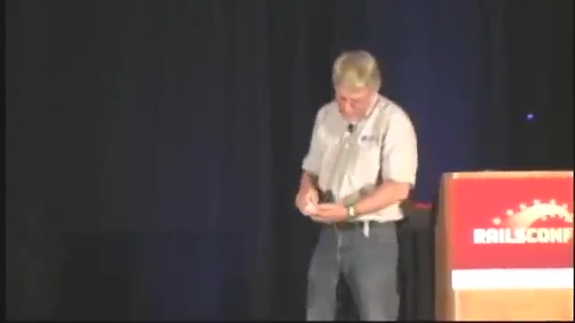
Uncle Bob about Ward Cunningham definition of Clean Code

Slide 11
Go history

Slide 12
Go history
Conceptual work started in late 2007.
Uncle Bob’s book was published 1.08.2008
- Robert Griesemer, Rob Pike and Ken Thompson.
- Ian Lance Taylor and Russ Cox.
Open sourced in 2009.
Version 1.0 published in 2012

Slide 13
Why Google created Golang?
Go is the answer on the problem of engineering scale at Google
In 2011:
- 5000+ developers across 40+ offices
- 20+ changes per minute
- 50% of code base changes every month
- 50 million test cases executed per day
- single code tree
Solution: design the language for large code bases

Slide 14
Google - observations
The less code we need read the better - inheritance hierarchy is bad, operators overloading is bad etc.
We read code far more often than we write it
Code lives longer that we expect
Usually maintainer of the code is not the person who wrote that code
In big organizations programming skills may be vary
Processors speed is not increasing as expected(Moore's law is failing)

Slide 15
Golang - assumptions
Go should be:
clean procedural language
simple
readable
maintainable
concise

Slide 16
Ward’s definition of Clean Code
You know you are working with clean code when each routine you read turns out to be pretty much what you expected.

Slide 17
Golang in context of time
Golang code written 10 years ago looks almost the same as Golang code written nowadays.

Slide 18
Why I think that Go is the cleanest programming language

Slide 19
Go does not compete on features

Slide 20
Golang does not compete on features
New versions of Java, JavaScript (ECMAScript), Typescript, C#, C++, Hack (PHP) and many more add new features.
These languages actively borrow features from one another.
They are converging into a single huge language.
Source: https://talks.golang.org/2015/simplicity-is-complicated.slide

Slide 21
Golang does not compete on features
Go is different.
Go does not try to be like the other languages.
Go does not compete on features.
As of Go 1, the language is fixed.
Many newcomers to Go ask for features from languages they know. But those features do not belong in Go—and the language is fixed.
Adding features to Go would not make it better, just bigger.
That would make Go less interesting by being less different.
Source: https://talks.golang.org/2015/simplicity-is-complicated.slide

Slide 22
Small Specification

Slide 23
Small specification
Java 8 spec - 788 pages PDF -> http://docs.oracle.com/javase/specs/jls/se8/jls8.pdf
Scala spec - 191 pages PDF -> http://www.scala-lang.org/docu/files/ScalaReference.pdf
Python spec - 150 pages PDF -> https://docs.python.org/3/reference/
Golang spec - 51 pages PDF -> https://golang.org/ref/spec

Slide 24
A bit primitive but very concise

Slide 25
A bit primitive but very concise
If a language has too many features, you waste time choosing which ones to use.
Then implement, refine, possibly rethink and redo.
Preferable to have just one way, or at least fewer, simpler ways.
Features add complexity. Go wants simplicity.
Features hurt readability. Go wants readability.
Readability is paramount.
Source: https://talks.golang.org/2015/simplicity-is-complicated.slide

Slide 26
Dead simple syntax

Slide 27
Dead simple syntax
Java or C# have more than 50 keywords, Go - only 25
Less features = less keywords
Simple scoping rules
If package level variables start with a lowercase letter, they are scoped to the package. If they start with upper-case, it means variables are scoped publically.
Build-In garbage collection
Go creators built-in the garbage collection to simplify memory management which helps to write clean code and eliminate tech debt right away.

Slide 28
Auto formatter

Slide 29
Build-In auto formatter
Go has auto formatter build-in
Every Golang IDE runs go fmt automatically
Gofmt'd code is:
easier to write: never worry about minor formatting concerns while hacking away,
easier to read: when all code looks the same you need not mentally convert others' formatting style into something you can understand.
easier to maintain: mechanical changes to the source don't cause unrelated changes to the file's formatting; diffs show only the real changes.
uncontroversial: never have a debate about spacing or brace position ever again!
$ go fmt path/to/your/package

Slide 30
Linters

Slide 31
Linters
Beacause of Golang simplicity its really easy to write liners for Go code
Some of them are threated as standard eg. Gometalinter
Most important ones:
unchecked errors;
exported interfaces, structs, methods and functions without comments;
impropely named variables(even with underscores in them, i.e. some_variable).

Slide 32
Linters
go vet - Reports potential errors that otherwise compile.
go tool vet --shadow - Reports variables that may have been unintentionally shadowed.
gotype - Syntactic and semantic analysis similar to the Go compiler.
gotype -x - Syntactic and semantic analysis in external test packages (similar to the Go compiler).
deadcode - Finds unused code.
gocyclo - Computes the cyclomatic complexity of functions.
golint - Google's (mostly stylistic) linter.
varcheck - Find unused global variables and constants.
structcheck - Find unused struct fields.
maligned - Detect structs that would take less memory if their fields were sorted.
errcheck - Check that error return values are used.
megacheck - Run staticcheck, gosimple and unused, sharing work.
dupl - Reports potentially duplicated code.
ineffassign - Detect when assignments to existing variables are not used.
interfacer - Suggest narrower interfaces that can be used.
unconvert - Detect redundant type conversions.
goconst - Finds repeated strings that could be replaced by a constant.
gosec - Inspects source code for security problems by scanning the Go AST.

Slide 33
Documentation

Slide 34
Documentation
Documentation is a huge part of making software accessible and maintainable. Its one of characteristic of Clean Code
Go has a great emphasis on simple, no-nonsense documentation right out of the box.
The comments read by godoc are not language constructs (as with Docstring) nor must they have their own machine-readable syntax (as with Javadoc).
All documentation in one place: https://godoc.org/
You can even run your local server with godoc
Example: https://godoc.org/github.com/mateuszdyminski/bloom-filter/bloom

Slide 35
Dependencies

Slide 36
Dependencies
Code with unused dependency would not compile
One of the Golang proverb: „a little copying is better than a little dependency”
Keep your dependency tree small
If you could copy 5 lines of code instead of add new dependency – do that!
Even golang standard library is doing that!

Slide 37
No inheritance

Slide 38
No inheritance
Rather than requiring the programmer to declare ahead of time that two types are related, in Go a type automatically satisfies any interface that specifies a subset of its methods.
Types can satisfy many interfaces at once, without the complexities of traditional multiple inheritance.
It takes some getting used to but this implicit style of type dependency is one of the most productive things about Go.

Slide 39
No overloading

Slide 40
No overloading
Method dispatch is simplified if it doesn't need to do type matching as well. Experience with other languages told us that having a variety of methods with the same name but different signatures was occasionally useful but that it could also be confusing and fragile in practice.
Matching only by name and requiring consistency in the types was a major simplifying decision in Go's type system.
Regarding operator overloading, it seems more a convenience than an absolute requirement. Again, things are simpler without it.

Slide 41
No exceptions

Slide 42
No exceptions
We believe that coupling exceptions to a control structure, as in the try-catch-finally idiom, results in convoluted code. It also tends to encourage programmers to label too many ordinary errors, such as failing to open a file, as exceptional.
For plain error handling, Go's multi-value returns make it easy to report an error without overloading the return value.
Go also has a couple of built-in functions to signal and recover from truly exceptional conditions. See the Defer, Panic, and Recover The recovery mechanism is executed only as part of a function's state being torn down after an error, which is sufficient to handle catastrophe.

Slide 43
Error handling

Slide 44
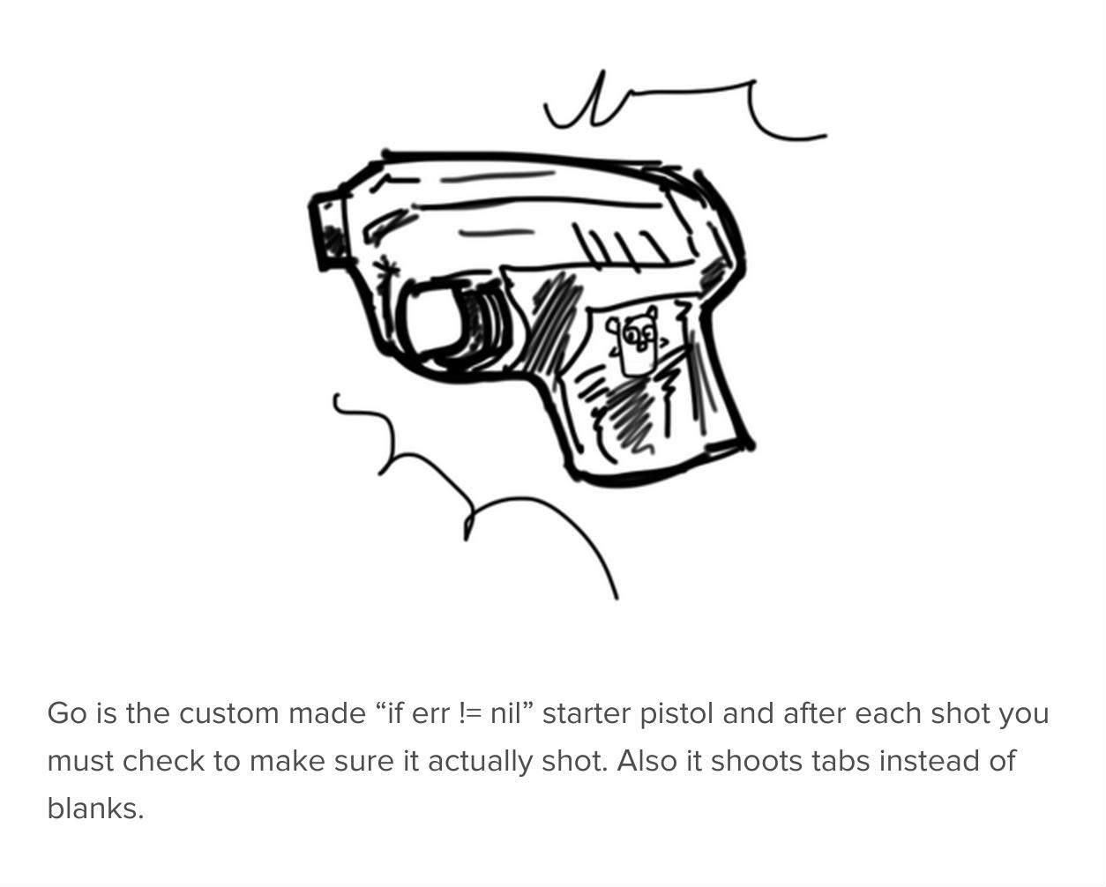
Error handling

Slide 45
Error handling
In Go, a common complaint from newly-minted gophers who come from another language is the error handling pattern:
Any time we write similar-looking code over and over, that’s considered boilerplate.
result, err := DoSomething()
if err != nil {
return nil, err
}
another, err := SomethingElse(result)
if err != nil {
return nil, err
}
if err := MoreWork(another); err != nil {
return nil, err
}
...

Slide 46
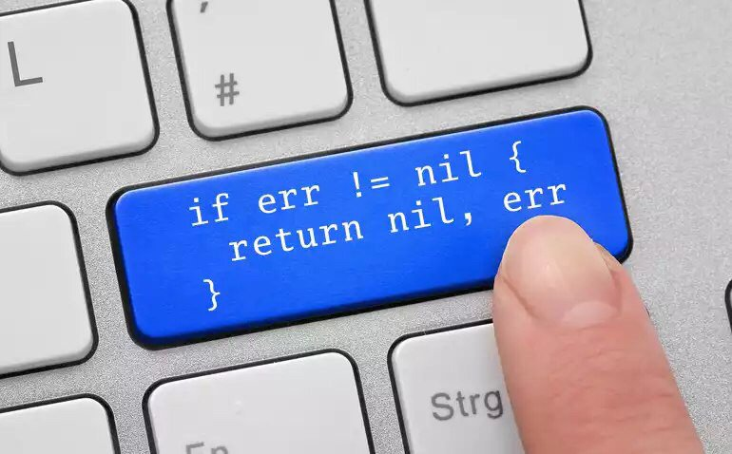
Error handling
An error check is always an error check – and its far better than exception propagation or try-catch-finally clause
Solution:

Slide 47
No generics

Slide 48
No exceptions
Generics may well be added at some point. We don't feel an urgency for them, although we understand some programmers do.
The language is more mature now, and there is scope to consider some form of generic programming. However, there remain some caveats.
Generics are convenient but they come at a cost in complexity in the type system and run-time. We haven't yet found a design that gives value proportionate to the complexity, although we continue to think about it.
The topic remains open. For a look at several previous unsuccessful attempts to design a good generics solution for Go, see this proposal.

Slide 49
No func/struct annotations

Slide 50
No func/struct annotation
No Java style annotations, but golang has tags
An Annotation is evil, if it represents some additional functionality or constraint that alters runtime behavior of code. This is bad, because it hides aspects of a class or method and therefore makes the Code harder to understand, reuse, debug, refactor and to test.

Slide 51
Not always Golang shines

Slide 52
func printUsers(filter string) {
filtered := make([]user, 0, 0)
for _, u := range users {
if strings.Contains(u.name, filter) {
filtered = append(filtered, u)
}
}
sort.Sort(byName(filtered))
for _, u := range filtered {
fmt.Printf("user: %v \n", u)
}
}
type byName []user
func (s byName) Len() int {
return len(s)
}
func (s byName) Swap(i, j int) {
s[i], s[j] = s[j], s[i]
}
func (s byName) Less(i, j int) bool {
return s[i].name < s[j].name
}
public static void printUsers(String filter) {
users.stream()
.filter(p -> p.getName().contains(filter))
.sorted(Comparator.comparing(User::getName))
.forEach(u -> System.out.println(u));
}
LoC: Go vs Java - 24 vs 6

Slide 53
Summary

Slide 54
Summry
You could learn Go in 24h
https://tour.golang.org
https://golang.org/doc/effective_go.html
After 24h you could write production grade code
Golang code written 10 years ago looks almost the same as Golang code written nowadays.
Go code looks boring and ugly – but you will know what’s doing

Slide 55
Summry
Writing clean code in Go is really easy
Go as programming language supports you in writing Clean Code
Go is cleanest programming language
Every programmer should learn Go

Slide 56
Thank you!

